Slide 1
Lecture 17
Signals and Systems (ELL205)
By Dr. Abhishek Dixit
Dept. of Electrical Engineering
IIT Delhi

Slide 2
Signals as Vectors

Slide 3
Outline
Introduction to vectors
Introduction to inner product and projection theorem
Introduction to signals as vectors

Slide 4
Vector Spaces
2D vector
v + u
(x,y)
u
v

Slide 5
Vector Spaces
2D vector
αv
v

Slide 6
Vector Spaces
3D vector
v + u
u
v
(x,y,z)

Slide 7
Vector Spaces
3D vector
αv
v

Slide 8
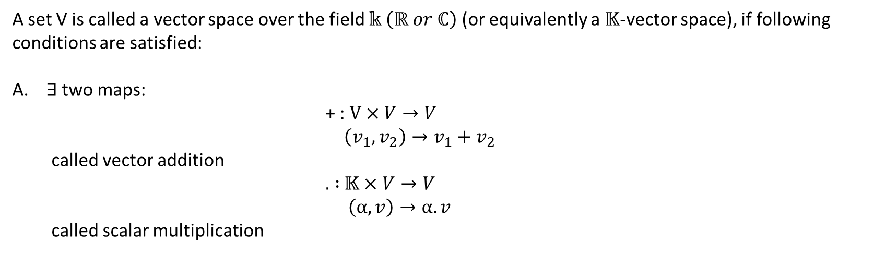
Vector Spaces
A set V is called a vector space over the field $𝕜 \left(ℝ or ℂ\right)$ (or equivalently a $𝕂$-vector space), if following conditions are satisfied:
$∃$ two maps:
                + : $V×V→V$
  $$\left(v_{1},v_{2}\right)→v_{1}+v_{2}$$
  called vector addition
                $.$ $:$ $𝕂×V→V$
                $\left(α,v\right)→α.v$
  called scalar multiplication

Slide 9
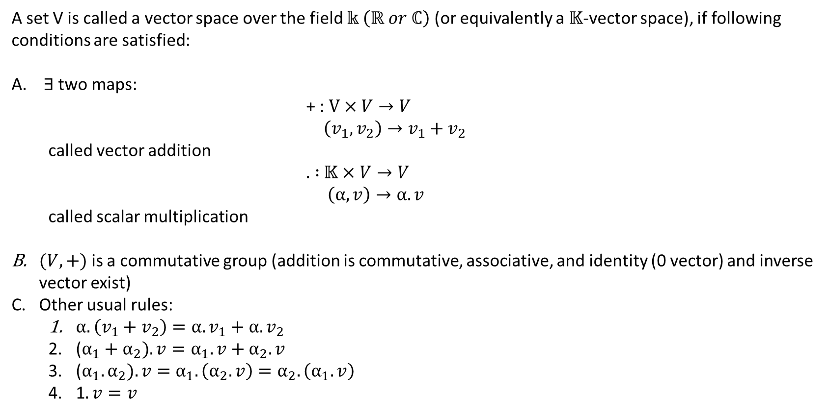
Vector Spaces
A set V is called a vector space over the field $𝕜 \left(ℝ or ℂ\right)$ (or equivalently a $𝕂$-vector space), if following conditions are satisfied:
$∃$ two maps:
                + : $V×V→V$
  $$\left(v_{1},v_{2}\right)→v_{1}+v_{2}$$
  called vector addition
                $.$ $:$ $𝕂×V→V$
                $\left(α,v\right)→α.v$
  called scalar multiplication
$(V,+)$ is a commutative group (addition is commutative, associative, and identity (0 vector) and inverse vector exist)
Other usual rules:
  $α.\left(v_{1}+v_{2}\right)=α.v_{1}+α.v_{2}$
  ($α_{1}+α_{2}). v=α_{1}.v+α_{2}.v$
  ($α_{1}.α_{2}). v=α_{1}.\left(α_{2}.v\right)=α_{2}.\left(α_{1}.v\right)$
  1$.v=v$

Slide 10
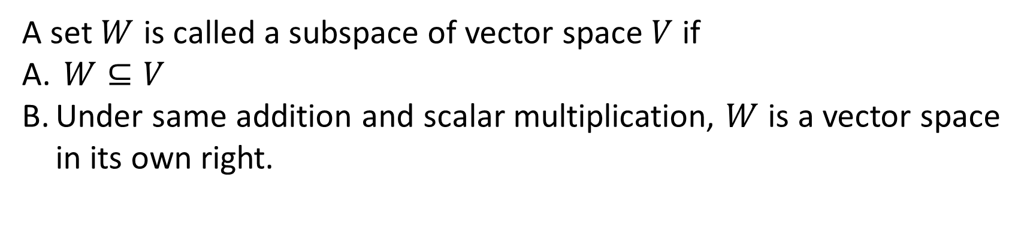
Subspace of Vector Spaces
A set $W$ is called a subspace of vector space $V$ if
$W⊆V$
Under same addition and scalar multiplication, $W$ is a vector space in its own right.

Slide 11
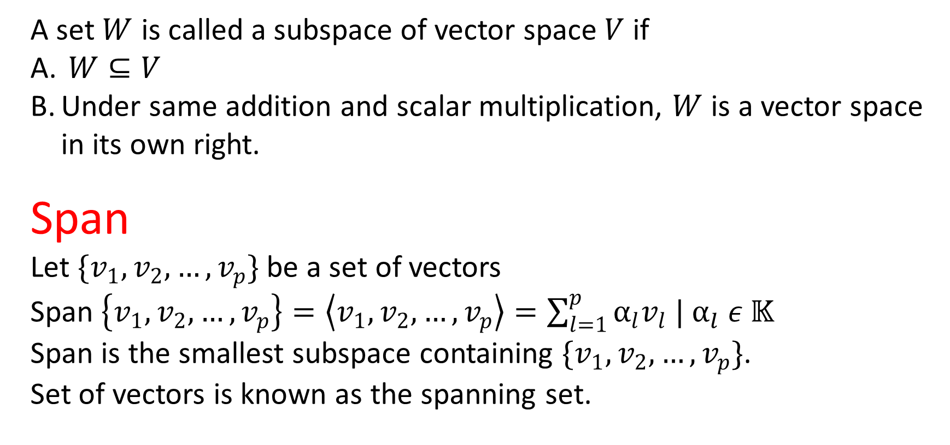
Subspace of Vector Spaces
A set $W$ is called a subspace of vector space $V$ if
$W⊆V$
Under same addition and scalar multiplication, $W$ is a vector space in its own right.
Span
Let $\{v_{1},v_{2},…,v_{p}\}$ be a set of vectors
Span $\left\{v_{1},v_{2},…,v_{p}\right\}=\left\langle v_{1},v_{2},…,v_{p}\right\rangle =\sum_{l=1}^{p}{α_{l}v_{l} |}$ $α_{l} ε 𝕂$
Span is the smallest subspace containing $\{v_{1},v_{2},…,v_{p}\}$.
Set of vectors is known as the spanning set.

Slide 12
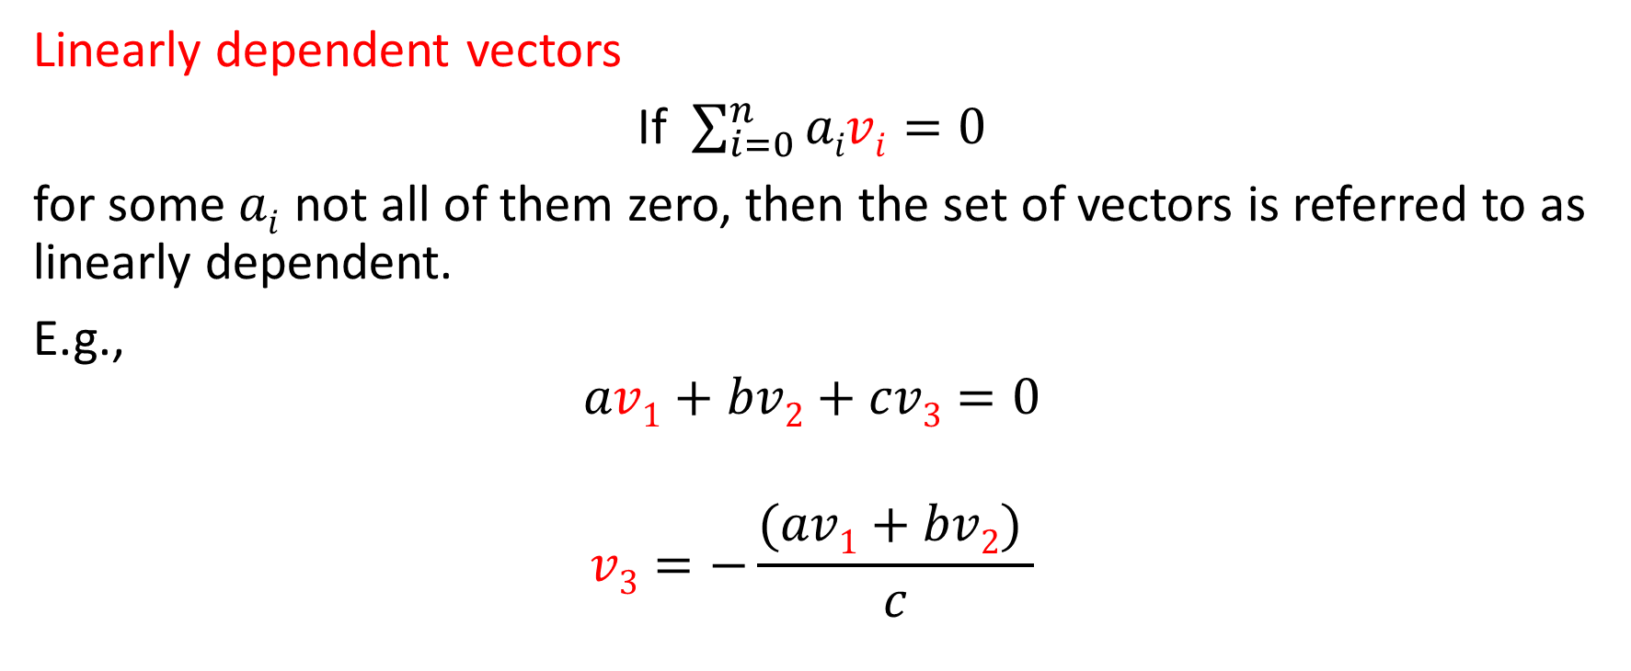
Linear independence of vectors
Linearly dependent vectors
If $\sum_{i=0}^{n}{aivi=0}$
for some $ai$ not all of them zero, then the set of vectors is referred to as linearly dependent.
E.g.,
$$av1+bv2+cv3=0$$
$$v3=−\frac{(av1+bv2) }{c}$$

Slide 13
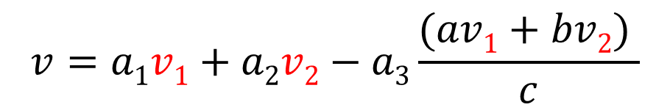

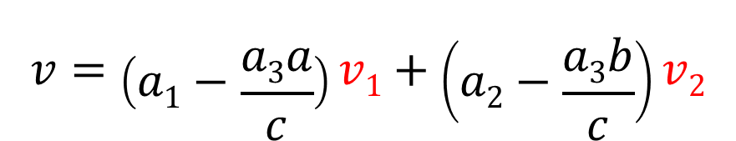

Linear independence of vectors
$$v3=−\frac{(av1+bv2) }{c}$$
$$v=a1v1+a2v2+a3v3$$
$$v=a1v1+a2v2−a3\frac{(av1+bv2) }{c}$$
$$v=\left(a1−\frac{a3a}{c}\right)v1+\left(a2−\frac{a3b}{c}\right)v2$$

Slide 14
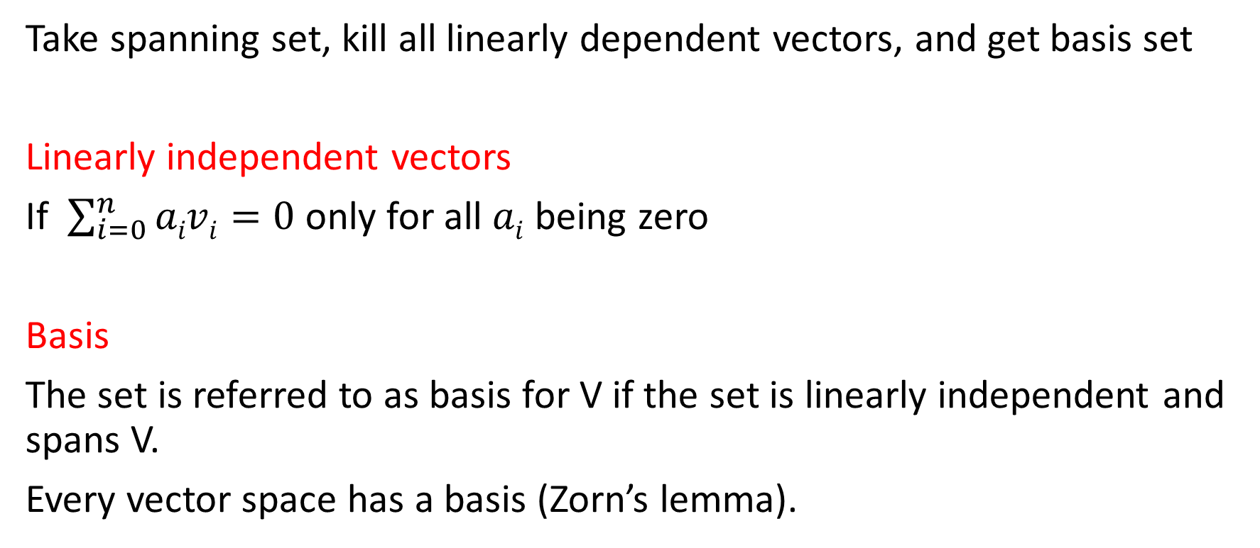
Linear independence of vectors
Take spanning set, kill all linearly dependent vectors, and get basis set
Linearly independent vectors
If $\sum_{i=0}^{n}{aivi=0}$ only for all $ai$ being zero
Basis
The set is referred to as basis for V if the set is linearly independent and spans V.
Every vector space has a basis (Zorn’s lemma).

Slide 15
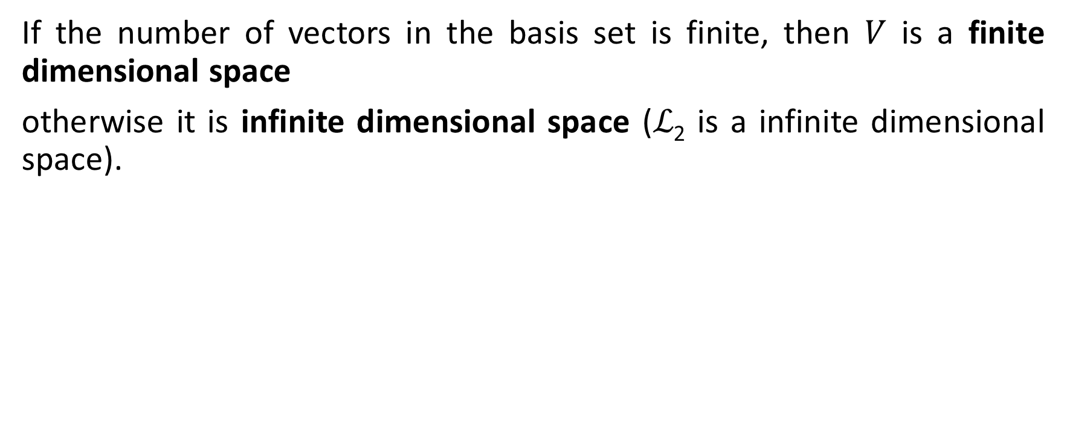
Dimension of the vector space
If the number of vectors in the basis set is finite, then $V$ is a finite dimensional space
otherwise it is infinite dimensional space (ℒ₂ is a infinite dimensional space).

Slide 16
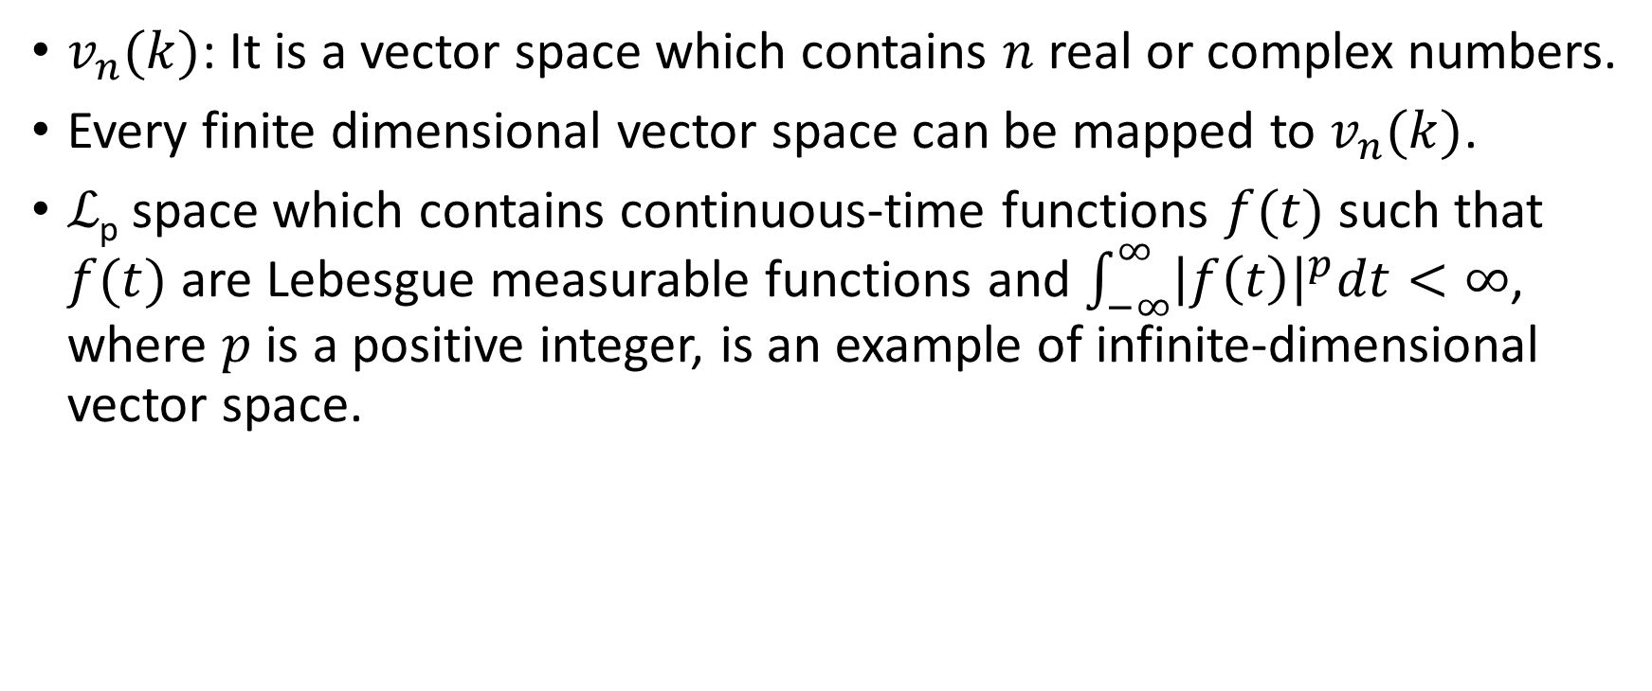
Examples of finite- and infinite-dimensional space
$v_{n}(k)$: It is a vector space which contains $n$ real or complex numbers.
Every finite dimensional vector space can be mapped to $v_{n}(k)$.
ℒ_{p} space which contains continuous-time functions $f(t)$ such that $f(t)$ are Lebesgue measurable functions and $\int_{−∞}^{∞}{{\left|f\left(t\right)\right|}^{p}dt<∞}$, where $p$ is a positive integer, is an example of infinite-dimensional vector space.

Slide 17
Outline
Introduction to vectors
Introduction to inner product and projection theorem
Introduction to signals as vectors

Slide 18
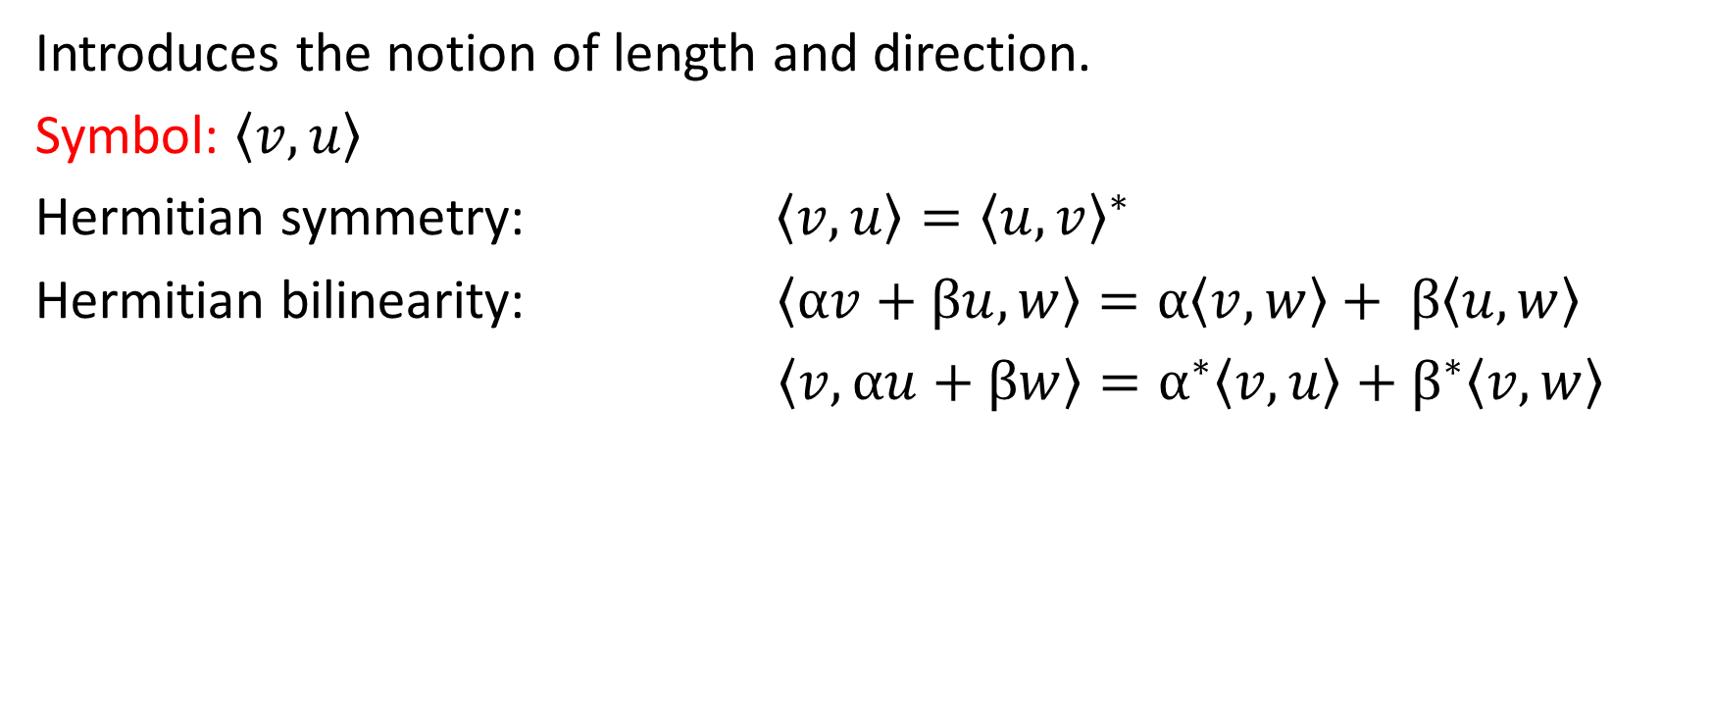
Inner Product Space
Introduces the notion of length and direction.
Symbol: $\left\langle v,u\right\rangle$
Hermitian symmetry: $\left\langle v,u\right\rangle ={\left\langle u,v\right\rangle }^{∗}$
Hermitian bilinearity: $\left\langle αv+βu,w\right\rangle =α\left\langle v,w\right\rangle + β\left\langle u,w\right\rangle$
$\left\langle v,αu+βw\right\rangle =α^{∗}\left\langle v,u\right\rangle +β^{∗}\left\langle v,w\right\rangle$

Slide 19
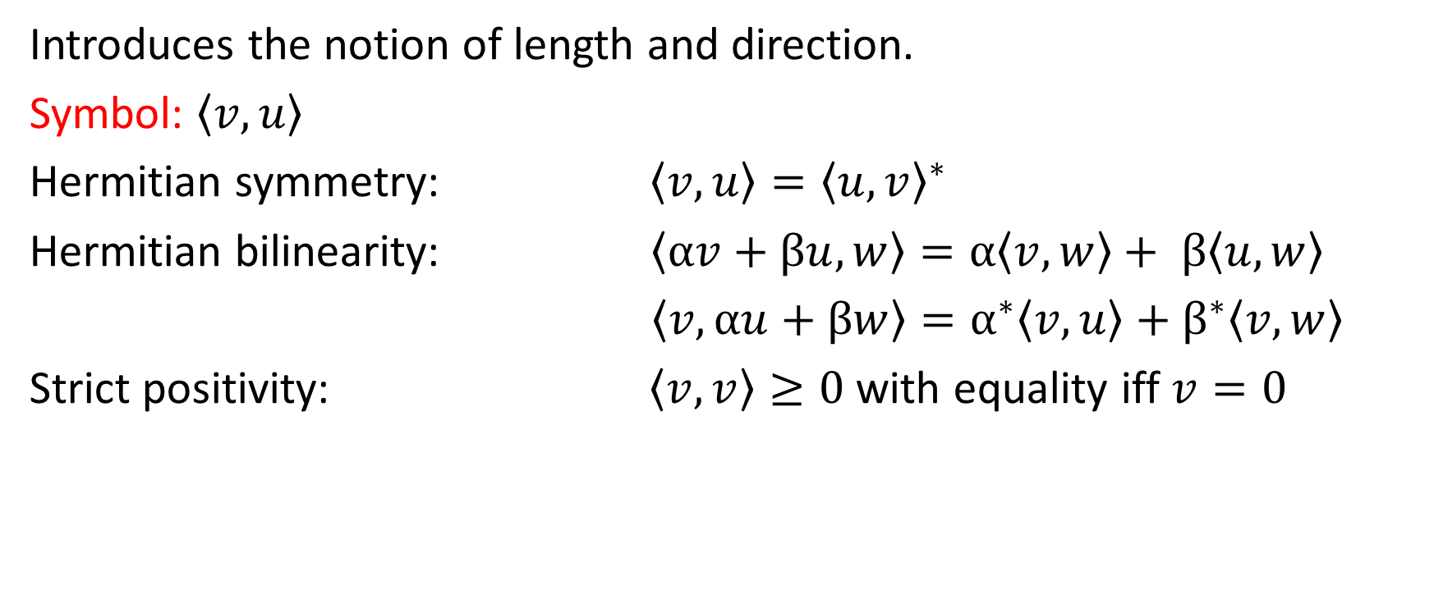
Inner Product Space
Introduces the notion of length and direction.
Symbol: $\left\langle v,u\right\rangle$
Hermitian symmetry: $\left\langle v,u\right\rangle ={\left\langle u,v\right\rangle }^{∗}$
Hermitian bilinearity: $\left\langle αv+βu,w\right\rangle =α\left\langle v,w\right\rangle + β\left\langle u,w\right\rangle$
$\left\langle v,αu+βw\right\rangle =α^{∗}\left\langle v,u\right\rangle +β^{∗}\left\langle v,w\right\rangle$
Strict positivity: $\left\langle v,v\right\rangle ≥0$ with equality iff $v=0$

Slide 20
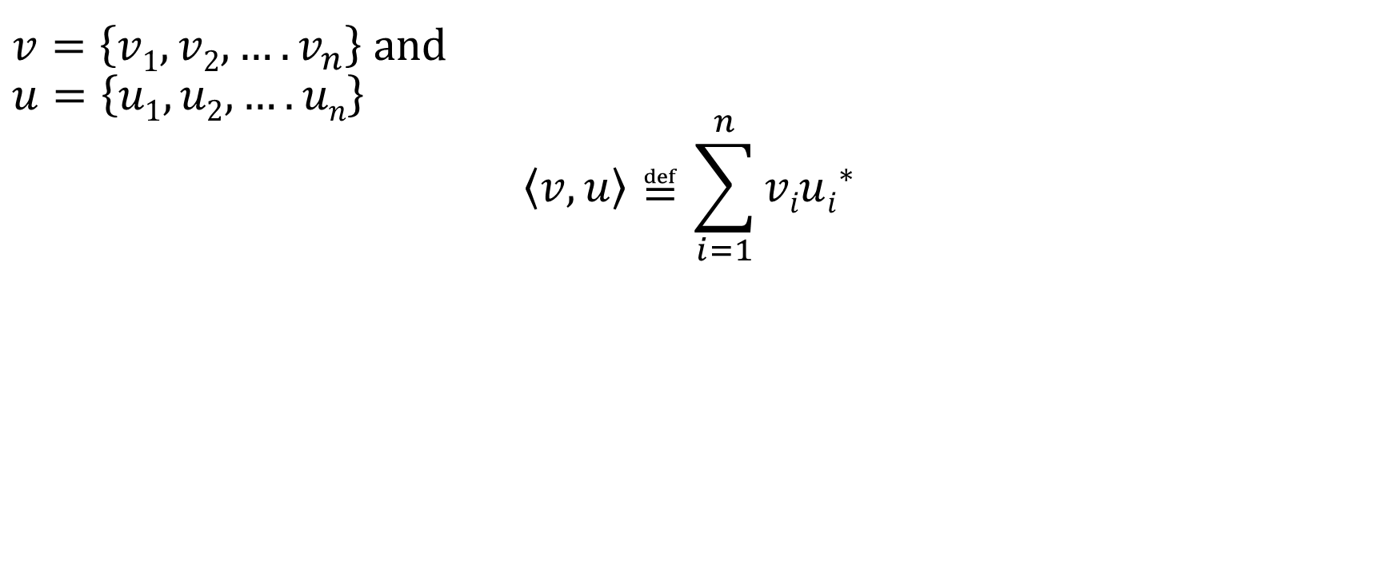
Inner Product Space
$v=\left\{v1,v2,….v_{n}\right\}$ and
$$u=\left\{u1,u2,….un\right\}$$
$$\left\langle v,u\right\rangle ≝\sum_{i=1}^{n}{viui^{∗}}$$

Slide 21
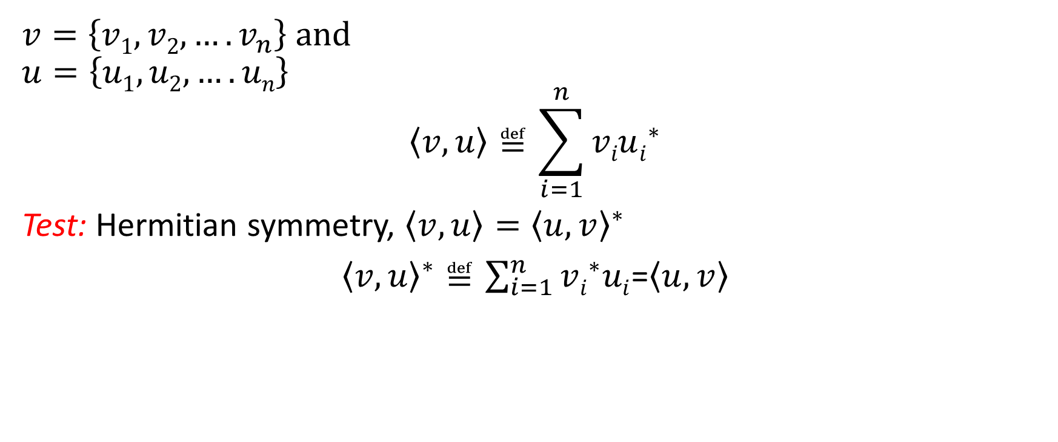
Inner Product Space
$v=\left\{v1,v2,….v_{n}\right\}$ and
$$u=\left\{u1,u2,….un\right\}$$
$$\left\langle v,u\right\rangle ≝\sum_{i=1}^{n}{viui^{∗}}$$
Test: Hermitian symmetry, $\left\langle v,u\right\rangle ={\left\langle u,v\right\rangle }^{∗}$
${\left\langle v,u\right\rangle }^{∗}≝\sum_{i=1}^{n}{vi^{∗}ui}$=$\left\langle u,v\right\rangle$

Slide 22
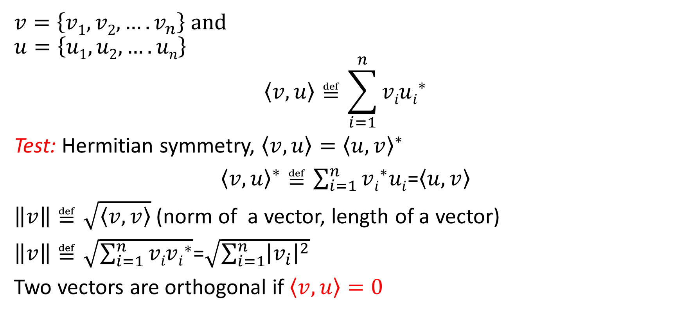
Inner Product Space
$v=\left\{v1,v2,….v_{n}\right\}$ and
$$u=\left\{u1,u2,….un\right\}$$
$$\left\langle v,u\right\rangle ≝\sum_{i=1}^{n}{viui^{∗}}$$
Test: Hermitian symmetry, $\left\langle v,u\right\rangle ={\left\langle u,v\right\rangle }^{∗}$
${\left\langle v,u\right\rangle }^{∗}≝\sum_{i=1}^{n}{vi^{∗}ui}$=$\left\langle u,v\right\rangle$
$\left\|v\right\|≝\sqrt{\left\langle v,v\right\rangle }$(norm of a vector, length of a vector)
$\left\|v\right\|≝\sqrt{\sum_{i=1}^{n}{vivi^{∗}}}$=$\sqrt{\sum_{i=1}^{n}{{\left|v_{i}\right|}^{2}}}$
Two vectors are orthogonal if $\left\langle v,u\right\rangle =0$

Slide 23
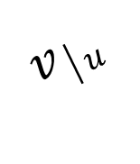
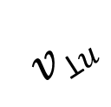
One dimension projection theorem
$$vꓕu$$
v
u
$$v│u$$

Slide 24
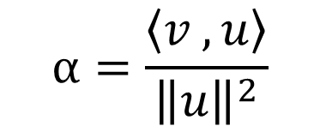

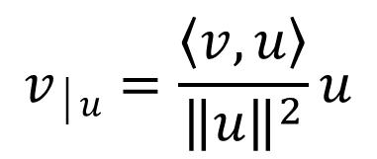

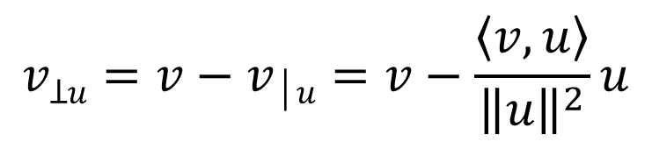
One dimension projection theorem
$$v│u=αu$$
$$\left\langle v−v│u,u\right\rangle =0$$
$$vꓕu$$
$$\left\langle v−αu ,u\right\rangle =\left\langle v ,u\right\rangle −α\left\langle u ,u\right\rangle =0$$
v
u
$$α=\frac{\left\langle v ,u\right\rangle }{{\left\|u\right\|}^{2}}$$
$$v│u$$
$$v│u=\frac{\left\langle v,u\right\rangle }{{\left\|u\right\|}^{2}}u$$
$$vꓕu=v−v│u=v−\frac{\left\langle v,u\right\rangle }{{\left\|u\right\|}^{2}}u$$

Slide 25
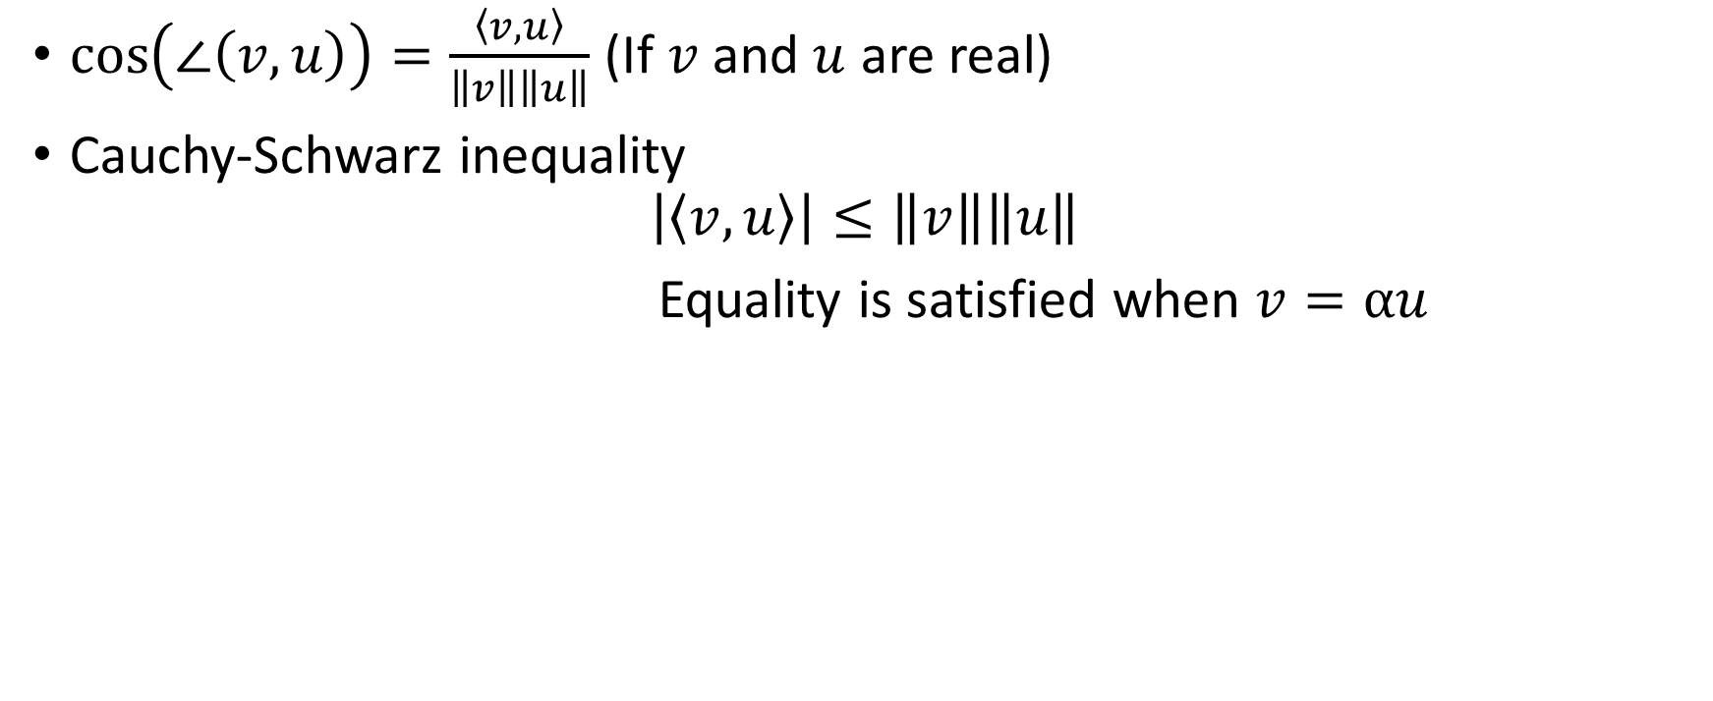
Direction
$\cos\left(∠\left(v,u\right)\right)=\frac{\left\langle v,u\right\rangle }{\left\|v\right\|\left\|u\right\|}$ (If $v$ and $u$ are real)
Cauchy-Schwarz inequality
$$\left|\left\langle v,u\right\rangle \right|≤\left\|v\right\|\left\|u\right\|$$
Equality is satisfied when $v=αu$

Slide 26
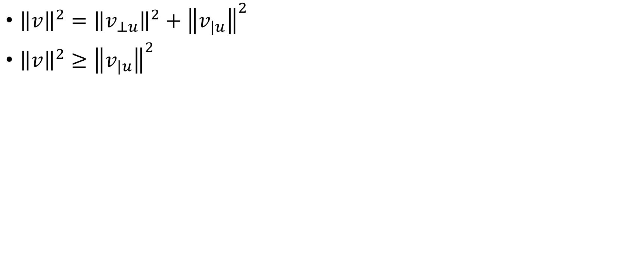
Proof of Cauchy-Schwarz inequality
${\left\|v\right\|}^{2}={\left\|v_{⊥u}\right\|}^{2}+{\left\|v_{|u}\right\|}^{2}$
${\left\|v\right\|}^{2}≥{\left\|v_{|u}\right\|}^{2}$

Slide 27
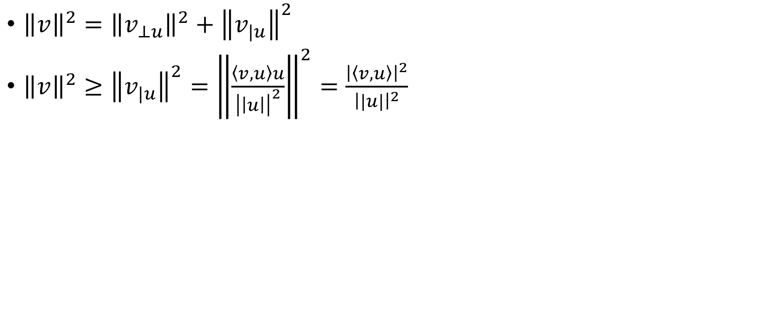
Proof of Cauchy-Schwarz inequality
${\left\|v\right\|}^{2}={\left\|v_{⊥u}\right\|}^{2}+{\left\|v_{|u}\right\|}^{2}$
${\left\|v\right\|}^{2}≥{\left\|v_{|u}\right\|}^{2}={\left\|\frac{\left\langle v,u\right\rangle u}{{\left|\left|u\right|\right|}^{2}}\right\|}^{2}=\frac{{\left|\left\langle v,u\right\rangle \right|}^{2}}{{\left||u|\right|}^{2}}$

Slide 28
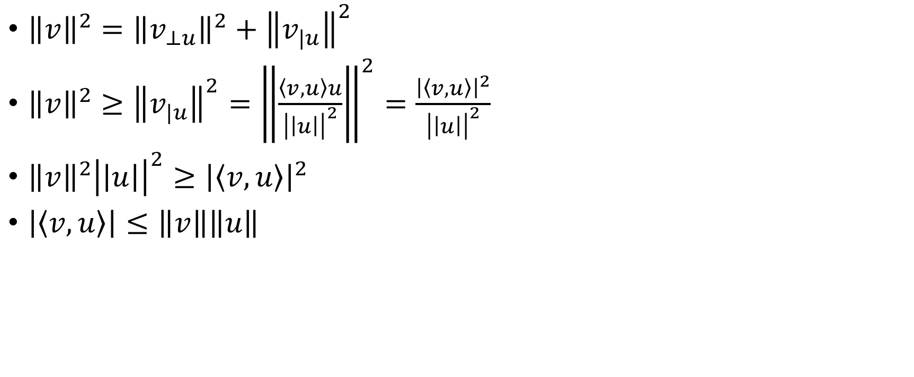
Proof of Cauchy-Schwarz inequality
${\left\|v\right\|}^{2}={\left\|v_{⊥u}\right\|}^{2}+{\left\|v_{|u}\right\|}^{2}$
${\left\|v\right\|}^{2}≥{\left\|v_{|u}\right\|}^{2}={\left\|\frac{\left\langle v,u\right\rangle u}{{\left|\left|u\right|\right|}^{2}}\right\|}^{2}=\frac{{\left|\left\langle v,u\right\rangle \right|}^{2}}{{\left|\left|u\right|\right|}^{2}}$
${\left\|v\right\|}^{2}{\left|\left|u\right|\right|}^{2}≥{\left|\left\langle v,u\right\rangle \right|}^{2}$
$\left|\left\langle v,u\right\rangle \right|≤\left\|v\right\|\left\|u\right\|$

